Slide 1

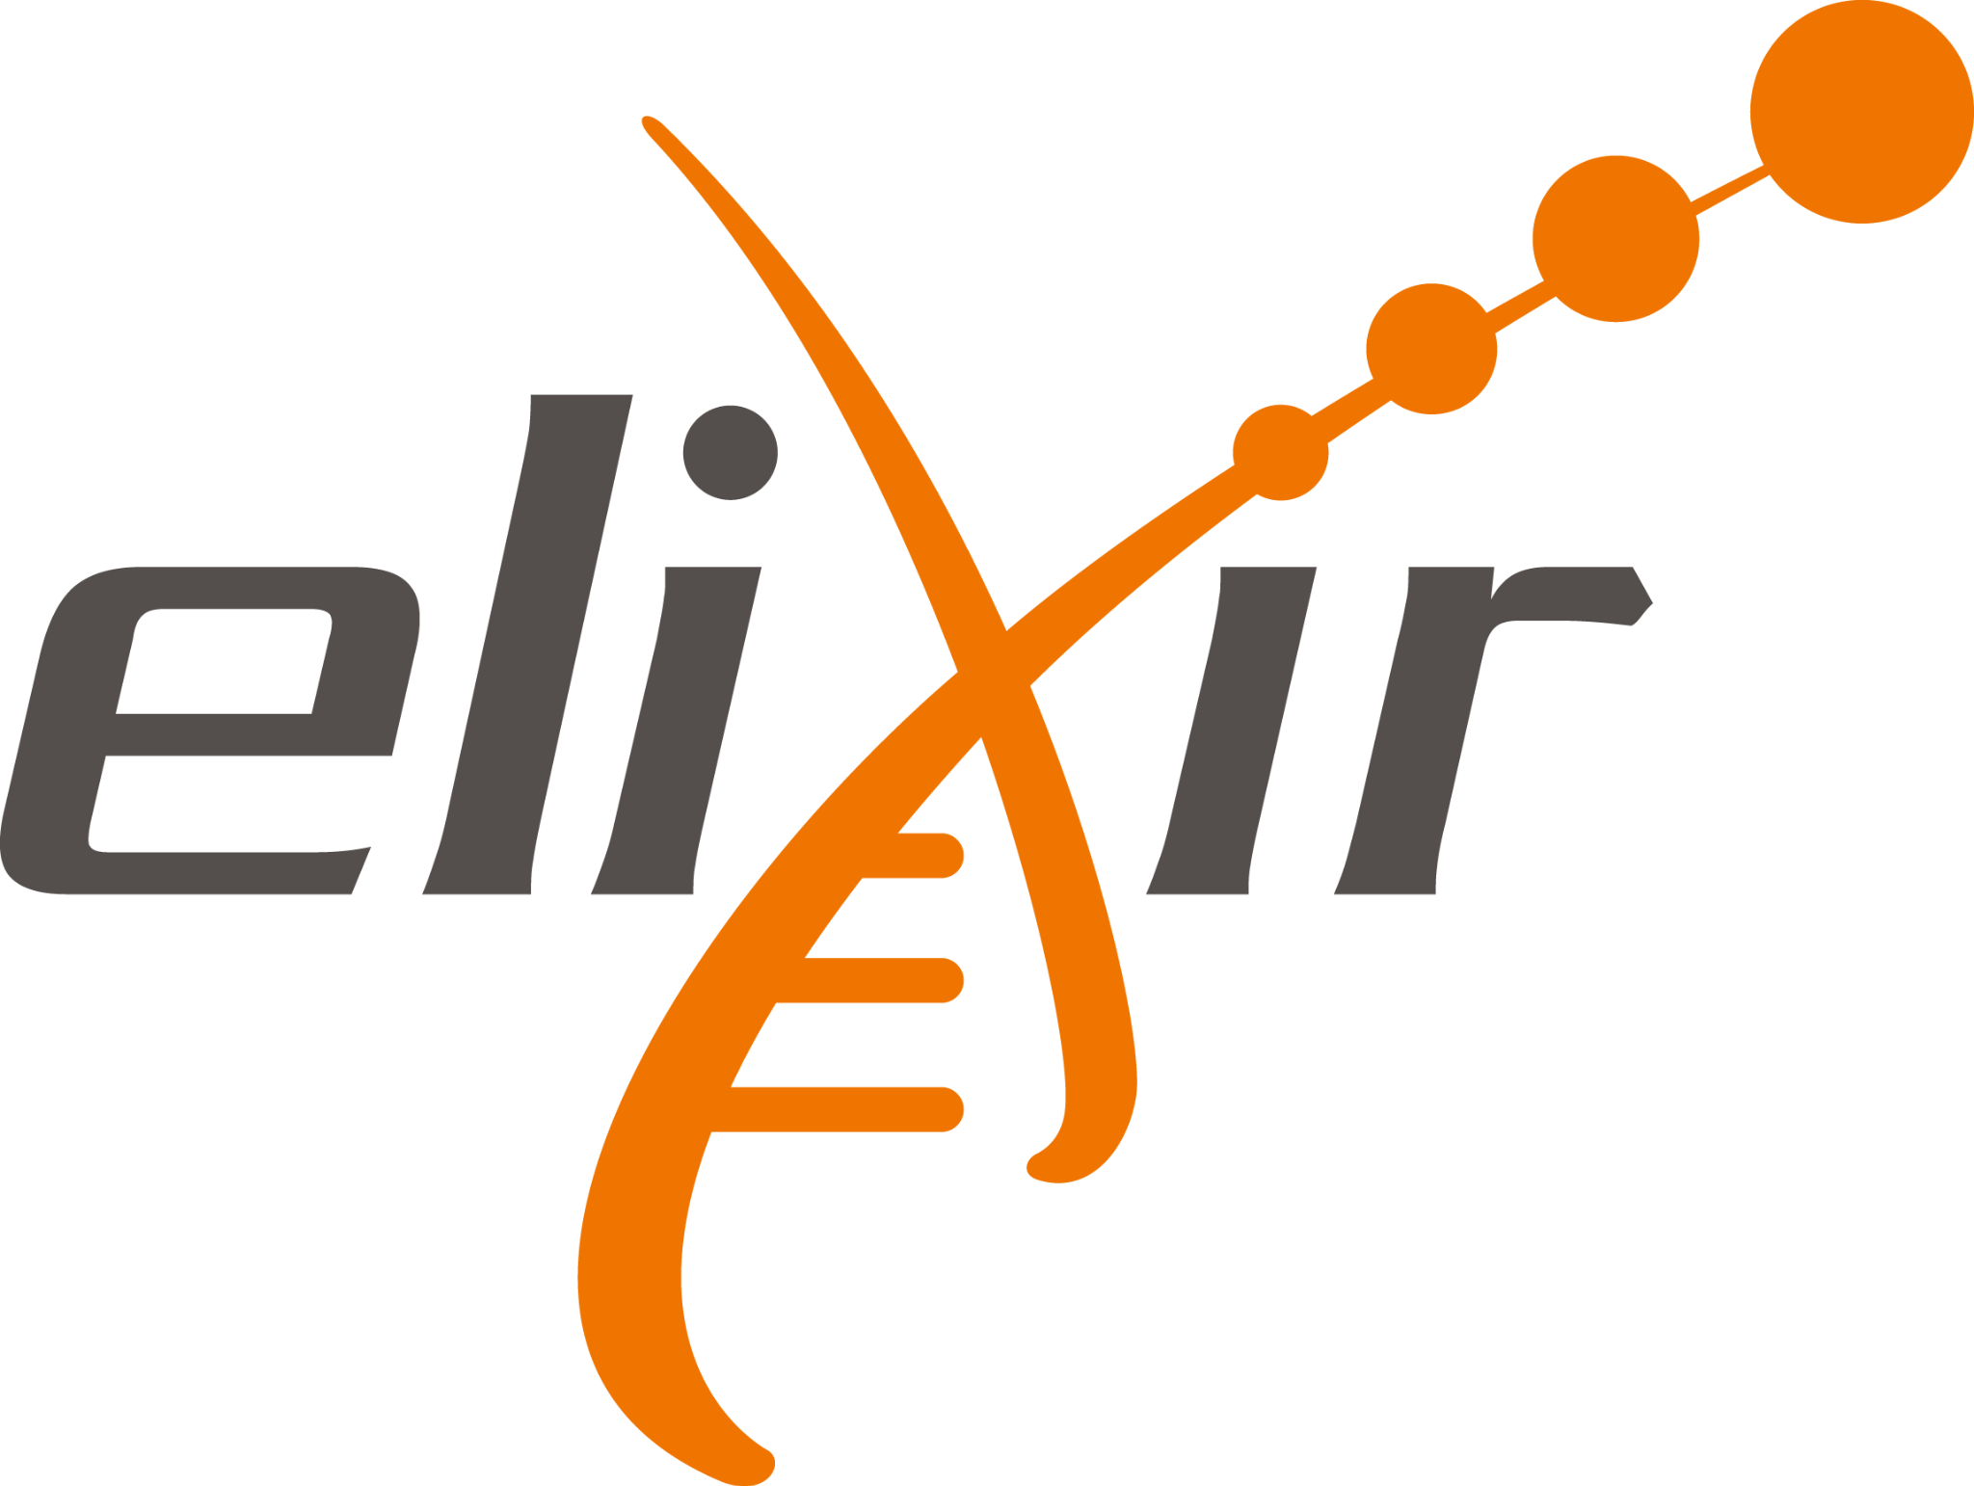

Acknowledgements
🧑🏽‍🤝‍🧑👩🏻‍🎨📽️📚
a broad overview
Author: Bruna Piereck
Contributor: Alexander Botzki
Version: 092024
Notes:
🔗 means it is a link you can click

Slide 2


: acknowledgement
“
”
To recognize the existence of something
To acknowledge someone as …
Notes:
In this extraction of the online dictionary we reflect on the broad meaning of what this word means, to recognize the existence of something, so we are going to reflect on the fact that some of the resources used for training were already existent and as consequence we need to appropriately inform someone as the author or owner of this resource. So somehow it is all linked.

Slide 3
Who are we acknowledging
?
?
Notes:
Give some time for the participants to reflect and list who they think of acknowledging. I would expect here that they think of authors of the material and maybe some resources were they search for information. It can happen that they forget about their own collaborators, possibly they don’t know yet or have not reflect yet on how to differentiate from authors. Also might forget about videos, images and songs since this resources we are less likely to worry about to make attributions, mostly finding them on browser search. Do not give all the answers but try to guide them a bit. Answers might come in next slides.

Slide 4




Who are we acknowledging
!
!
by @Uniconlabs
by @lutfix
by @AbtoCreative
?
?
by @Freepik
Authors
Contributors
Image owners
genAI tools
Notes:
_____________ Icons Attribution and link _________________
Contributors icon by @Uniconlabs on freepick: https://www.freepik.com/icon/collaboration_6713325#fromView=search&page=3&position=12&uuid=a4584cd3-d325-46b5-9525-451c0c8b83f1, Free for commercial use WITH ATTRIBUTION license *
Paint and brush by @AbtoCreative on freepick: https://www.freepik.com/icon/painting_4302155#fromView=search&page=3&position=2&uuid=5ec71ba2-e646-48b0-9dae-9ffd04b3800c , Free for commercial use WITH ATTRIBUTION license *
Paper and pen by @lutfix on freepik: https://www.freepik.com/icon/poetry_6535437#fromView=search&page=1&position=28&uuid=1f51d791-94bd-44ec-a1f3-91e119e01fe1 , Free for commercial use WITH ATTRIBUTION license *
Ai assistant by @Freepik: https://www.freepik.com/icon/ai-assistant_14247371#fromView=search&page=1&position=4&uuid=72609963-4de7-4115-ba4c-7127049de747, Free for commercial use WITH ATTRIBUTION license *
_____________ Slides notes _________________
Here you have the space to complement the answers. The Authors should be acknowledged for their par in the creation of training material, but also if something is re-used, remixes, adapted, etc. The source authors and material need to be properly attributed.
When creating training material usually others might review, test and participate in indirect ways or smaller scales, these are the contributors and they must be referred in the material. Usually when creating material we also use images and videos to illustrate the presentation or other material (see more about types of training material in the related session of this course) Despite of being used to just copy images from the internet we should always make attribution to the authors and sometimes to the image holder.
See for the example in this slide, all the icons have their attribution and in the slides notes you can see the attribution and the link to the original source. Same should be done if you are citing another material or article, include the link to the original source! For generative AI (genAI) tools, we might need to reflect a bit more: Who is the author and the owner?
At this point give the participants some time to express their opinion, keep that in mind when you come to the specific session so you can use their observations for discussions and to build upon.

Slide 5


Who are we acknowledging
!
!
by @Uniconlabs
by @lutfix
by @AbtoCreative
by @Freepik
Authors
Contributors
Image owners
genAI tools
By
@Smashicons
Licenses & Policies
Notes:
_____________ Icons Attribution and link _________________
Stamp V by @Smashicons on freepick: https://www.freepik.com/icon/stamp_1507479#fromView=search&page=2&position=15&uuid=4f1fd208-0787-4721-b76b-829814fc056e , Free for commercial use WITH ATTRIBUTION license *
Stamp X by @Smashicons on freepick: https://www.freepik.com/icon/stamp_1507480#fromView=search&page=2&position=14&uuid=4f1fd208-0787-4721-b76b-829814fc056e , Free for commercial use WITH ATTRIBUTION license *
Contributors icon by @Uniconlabs on freepick: https://www.freepik.com/icon/collaboration_6713325#fromView=search&page=3&position=12&uuid=a4584cd3-d325-46b5-9525-451c0c8b83f1 , Free for commercial use WITH ATTRIBUTION license *
Paint and brush by @AbtoCreative on freepick: https://www.freepik.com/icon/painting_4302155#fromView=search&page=3&position=2&uuid=5ec71ba2-e646-48b0-9dae-9ffd04b3800c , Free for commercial use WITH ATTRIBUTION license *
Paper and pen by @lutfix on freepik: https://www.freepik.com/icon/poetry_6535437#fromView=search&page=1&position=28&uuid=1f51d791-94bd-44ec-a1f3-91e119e01fe1 , Free for commercial use WITH ATTRIBUTION license *
Ai assistant by @Freepik: https://www.freepik.com/icon/ai-assistant_14247371#fromView=search&page=1&position=4&uuid=72609963-4de7-4115-ba4c-7127049de747, Free for commercial use WITH ATTRIBUTION license *
_____________ Slides notes _________________
All of these will be in some level related to the licenses and policies that come along with the material/resource. We will discuss different types of licenses, but in both cases (licenses or policies) have the intention to clarify what you can, cannot or must do when re-using this resource, they might even restrict or prohibit the re-use. What if you cannot find a license or a police?
Again, give them some time to think and share thoughts about this question!

Slide 6
Who are we acknowledging
!
!
by @Uniconlabs
by @lutfix
by @AbtoCreative
by @Freepik
Authors
Contributors
Image owners
genAI tools
By
@Smashicons
Licenses & Policies
Notes:
_____________ Icons Attribution and link _________________
Stamp V by @Smashicons on freepick: https://www.freepik.com/icon/stamp_1507479#fromView=search&page=2&position=15&uuid=4f1fd208-0787-4721-b76b-829814fc056e
Stamp X by @Smashicons on freepick: https://www.freepik.com/icon/stamp_1507480#fromView=search&page=2&position=14&uuid=4f1fd208-0787-4721-b76b-829814fc056e
Contributors icon by @Uniconlabs on freepick: https://www.freepik.com/icon/collaboration_6713325#fromView=search&page=3&position=12&uuid=a4584cd3-d325-46b5-9525-451c0c8b83f1
Paint and brush by @AbtoCreative on freepick: https://www.freepik.com/icon/painting_4302155#fromView=search&page=3&position=2&uuid=5ec71ba2-e646-48b0-9dae-9ffd04b3800c
Paper and pen by @lutfix on freepik: https://www.freepik.com/icon/poetry_6535437#fromView=search&page=1&position=28&uuid=1f51d791-94bd-44ec-a1f3-91e119e01fe1
Ai assistant by @Freepik: https://www.freepik.com/icon/ai-assistant_14247371#fromView=search&page=1&position=4&uuid=72609963-4de7-4115-ba4c-7127049de747
_____________ Slides notes _________________
In orange we have the Authors and Contributors, and here I want to make the point that those are not always related to the license or police, since from the perspective of content creators we need to reflect on it regardless of the license. We need to acknowledge who are the authors and contributors of the resources we are creating or participating on the creation. But we will talk it further in the following session. So far what we did is to introduce all the points of view we will approach and start some reflections.

Slide 7
By @Smashicons
Licenses & Policies
Notes:
_____________ Icons Attribution and link _________________
Stamp V by @Smashicons on freepick: https://www.freepik.com/icon/stamp_1507479#fromView=search&page=2&position=15&uuid=4f1fd208-0787-4721-b76b-829814fc056e , Free for commercial use WITH ATTRIBUTION license *
Stamp X by @Smashicons on freepick: https://www.freepik.com/icon/stamp_1507480#fromView=search&page=2&position=14&uuid=4f1fd208-0787-4721-b76b-829814fc056e , Free for commercial use WITH ATTRIBUTION license *

Slide 8

Licenses
Make the property rights clear & access and usability rules evident
To consider before
Creative Commons Licence (cc)
Cannot be revoked, updates only apply for new “users”
Only the copyrights holder can apply a CC license
If created in the job - individual is not the holder
REUSABLE
ACCESSIBLE
Notes:
_____________ Icons Attribution and link _________________
Stamp V by @Smashicons on freepick: https://www.freepik.com/icon/stamp_1507479#fromView=search&page=2&position=15&uuid=4f1fd208-0787-4721-b76b-829814fc056e , Free for commercial use WITH ATTRIBUTION license *
Reusable and Accessible, by Bruna, from https://docs.google.com/presentation/d/1JGVo7zzt_h-cBFS78Eh5m5TMsin6PLVd9wmmMnLEuCA/edit#slide=id.p : CC0 4.0 license https://creativecommons.org/public-domain/cc0/
_____________ Slides notes _________________
In the case of training materials the most commonly used kind of license is the creative commons (CC) license, while for software you have other options that are advised and we will not cover here. Before I come to show you the options of CC licenses, once you choose one there are a few things you should consider. The licenses can not be revoked, meaning if you have updated your license this new terms and conditions are only applicable to new users, old ones remain entitle the rules of when they got it.
Also important is that if you are creating it for your Job/company/Institution you probably don’t hold the ownership and therefore are not the one to choose the license. Of Course you can choose it in the name of your company but you must follow their practices or maybe you may consult with one of your superiors when doing it for the first time.
We, in this course, we advocate for FAIR and OPEN so you will pay attention and our material in under a CCBYNC license, what all of this means you are about to find out.

Slide 9
Licenses
Make the property rights clear & access and usability rules evident
To consider before
To check always
Creative Commons Licence (cc)
Cannot be revoked, updates only apply for new “users”
Only the copyrights holder can apply a CC license
If created in the job - individual is not the holder
Before reusing materials
Presentation
Text
Video
Before including an image
Photo
Illustration
Print-screen
REUSABLE
ACCESSIBLE
Notes:
_____________ Icons Attribution and link _________________
Stamp V by @Smashicons on freepick: https://www.freepik.com/icon/stamp_1507479#fromView=search&page=2&position=15&uuid=4f1fd208-0787-4721-b76b-829814fc056e
Reusable and Accessible created by author of this course and under a CC0 4.0 license https://creativecommons.org/public-domain/cc0/
_____________ Slides notes _________________
From your side, when creating your material you also have to check the licenses AWAYS before you (re)use others presentations, text, video, images including fotos, illustration, icons… avoid print-screens as it usually means you also don’t have the information about the license. It can be difficult sometimes to find the license or police to which the image or video are linked too since not everyone thinks of adding it. Therefore, whe it is your turn make sure to put it in a very visible place and link to the page with more extended information. We will talk more about images later!
If you cannot find a license or clear police statement, is better not (re)use it, since you cannot be sure of what you may and may not do or even if this resource is entitled copyrights.

Slide 10
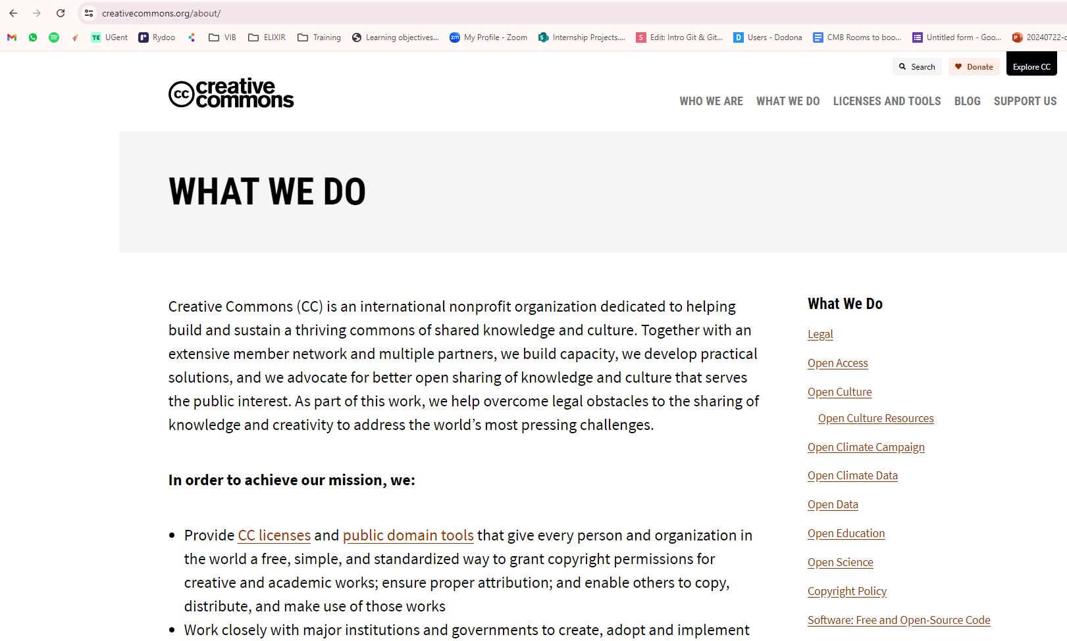
Choose a license for your project
?
?
Notes:
_____________ Slides notes _________________
This print introduces the Creative commons organization and what they do, they are no legal entity but they have created and are maintaining practical solutions for better sharing.

Slide 11
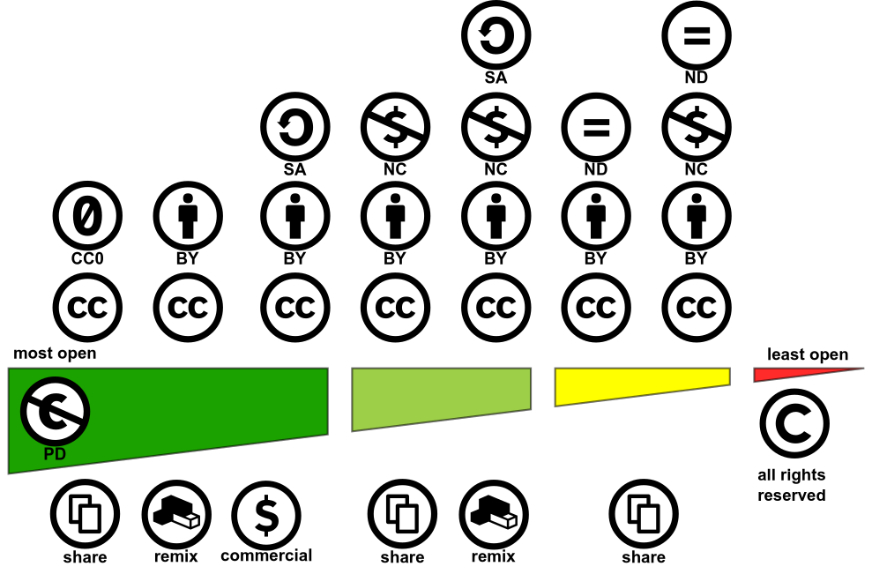
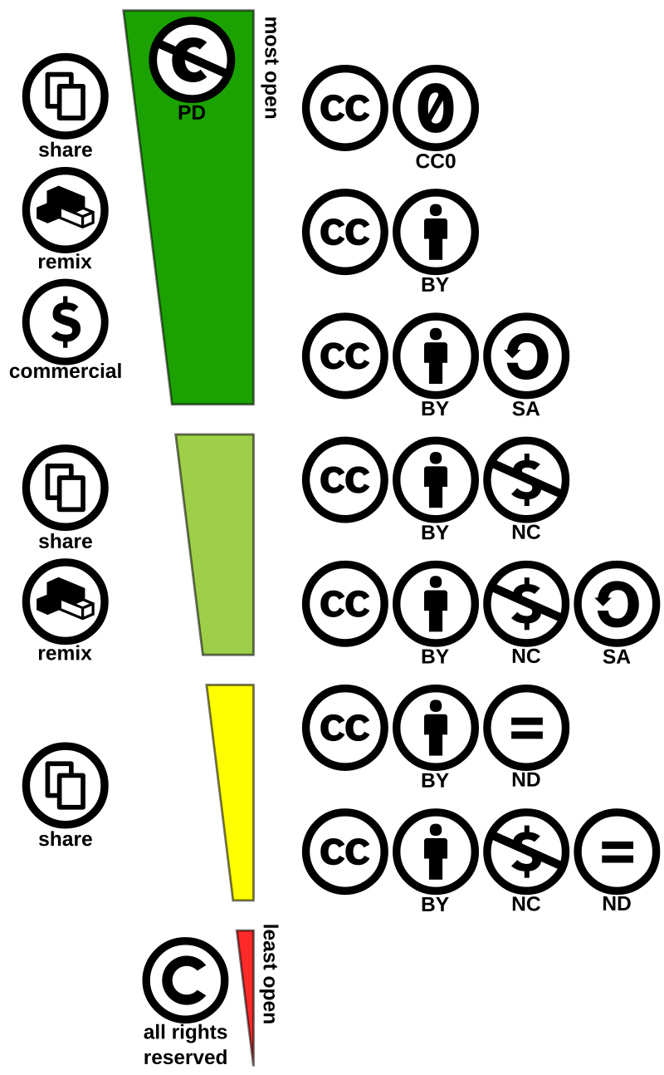


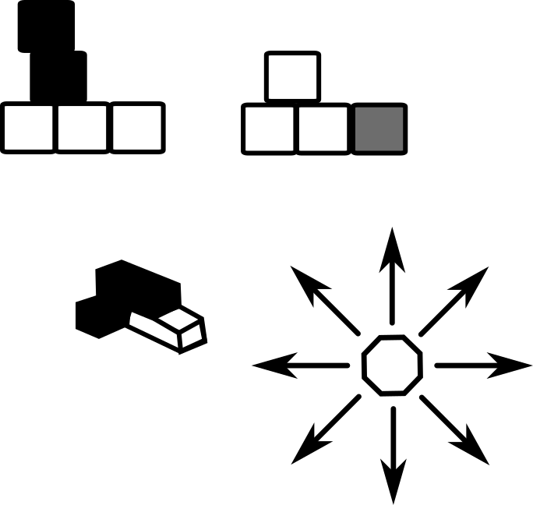
Licenses
Make the property rights clear & access and usability rules evident
Levels of openness
Public domain vs All rights reserved
: No rights reserved
: Attribution
: Share-alike
: Non-commercial
: Non-derivatives
Adapt
Build upon
Share
original CC license symbols by Creative Commons
Build upon & Adapt icon created by author of this course and under a CC0 4.0 license
Notes:
_____________ Icons Attribution and link _________________
Policies for icons of creative commons: https://creativecommons.org/policies/
Icons for download: https://creativecommons.org/mission/downloads/
Build upon icon created by author of this course and under a CC0 4.0 license https://creativecommons.org/public-domain/cc0/
Adapt icon created by author of this course and under a CC0 4.0 license https://creativecommons.org/public-domain/cc0/
_____________ Slides notes _________________
The creative commons organization has several statements (let’s call it like this for the sake of the explanation) and they can be combined in order to define the conditions of re-use of the material.
The most extremes options are Public domain and All right reserved. While public domain usually refers to things that have come to public domain but derivatives and some exceptions are made for copyrights that can make it a bit complex, usually it means everyone can (re)use and make derivatives of it. For example the art of Van Gogh is under public domain, but people that ceate inspired or derivatives of it can have the copyrights and ownership of their creations. While all rights reserved usually means that you cannot use unless under oficial legal agreements with the owners, for example Disney related.
But between these two there is a number of options that will come of the combination of the several statements. In the image on the slides you can find the CC0 (zero) that means someone is giving up all the rights so anyone can use, reuse, change as they feel like. It is similar to a Public domain license.
Then it follow with the “by” a CCBY means one can share, remix, adapt, build upon as ong as thei make proper attribution. Soon we’ll show an example of good and bad attributioons. The Share-alike menas you can do it all as long as you share under the same license type. Non-commercial, as intuitive as it may, means you can do it all as long is not for commercial use, in this case it is possible that different rules apply for comercial use or that it is not allowed at all. And non-derivative means you can share but cannot remix. Adapt nor buld-upon. You must keep it as it is!
They can be combined, and the combination creates the scare of opness. Let’s check it together in the next slide.

Slide 12
Licenses
Make the property rights clear & access and usability rules evident
Levels of openness
Public domain vs All rights reserved
: No rights reserved
: Attribution
: Share-alike
: Non-commercial
: Non-derivatives
by Shaddim; original CC license symbols by Creative Commons
Adapt
Build upon
Adapt
Build upon
Notes:
_____________ Icons Attribution and link _________________
Horizontalize Creative commons license spectrum, original by Shaddim; original CC license symbols by Creative Commons: https://commons.wikimedia.org/wiki/File:Creative_commons_license_spectrum.svg
Build upon icon created by author of this course and under a CC0 4.0 license https://creativecommons.org/public-domain/cc0/
Adapt icon created by author of this course and under a CC0 4.0 license https://creativecommons.org/public-domain/cc0/
_____________ Slides notes _________________
In this image is easy to visualize from the most open to the most close option of license, PD (Public domain) and CC0 share a relatively equal level of openness, and you can see the possible combinations and what is allowed.

Slide 13
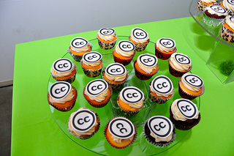
Licenses
Recommended practices
Photo by Timothy Vollmer

Slide 14
Licenses
Recommended practices
Photo: Creative Commons

Slide 15
Licenses
Recommended practices
Attribution
Title
Author
Source
License
Links
Title: Creative Commons 10th Birthday Celebration San Francisco
Author: Timothy Vollmer Source: Creative Commons 10th Birthday Celebration San Francisco
License: CC BY 4.0

Slide 16
Licenses
Recommended practices
Attribution
Title
Author
Source
License
Links
“Creative Commons 10th Birthday Celebration San Francisco" by Timothy Vollmer is licensed under CC BY 4.0

Slide 17
Licenses
Recommended practices
Attribution
Title
Author
Source
License
Links
Photo by Timothy Vollmer - CC BY 4.0

Slide 18
Licenses
Recommended practices
Attribution
Inform about modification!
Acknowledge the original
Photo by Timothy Vollmer - CC BY 4.0, cropped from original

Slide 19
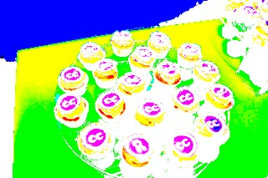
Licenses
Recommended practices
Attribution
Inform about modification!
Acknowledge the original
“90fied” adapted from Photo by Timothy Vollmer - CC BY 4.0

Slide 20

Licenses
Recommended practices
Include attribution with links in the description box
Theme music: “Day Bird” by Broke for Free (brokeforfree.com). Available for use under the CC BY 3.0 at Free Music Archive.
@Vitaly Gorbachev on Freepik
https://wiki.creativecommons.org/wiki/Recommended_practices_for_attribution
Notes:
https://www.freepik.com/icon/player_2992425#fromView=search&page=1&position=29&uuid=81b258c3-457d-4a52-a229-b618d123848f

Slide 21
by @Uniconlabs
by @lutfix
Authorship & Contributors
Notes:
_____________ Icons Attribution and link _________________
Contributors icon by @Uniconlabs on freepick: https://www.freepik.com/icon/collaboration_6713325#fromView=search&page=3&position=12&uuid=a4584cd3-d325-46b5-9525-451c0c8b83f1
Paper and pen by @lutfix on freepik: https://www.freepik.com/icon/poetry_6535437#fromView=search&page=1&position=28&uuid=1f51d791-94bd-44ec-a1f3-91e119e01fe1

Slide 22
How would you differentiate
by @Uniconlabs
Define author, share with another group and have collaboration on reviewing your lesson
by @lutfix
?
?
Authors
Contributors
Notes:
_____________ Icons Attribution and link _________________
Contributors icon by @Uniconlabs on freepick: https://www.freepik.com/icon/collaboration_6713325#fromView=search&page=3&position=12&uuid=a4584cd3-d325-46b5-9525-451c0c8b83f1
Paper and pen by @lutfix on freepik: https://www.freepik.com/icon/poetry_6535437#fromView=search&page=1&position=28&uuid=1f51d791-94bd-44ec-a1f3-91e119e01fe1
_____________ Slides notes _________________
Let the participants share how they think about it. Use this information to build the concepts based on what they have in mind in the next slides.

Slide 23
Authorship & Contributors
Authors
Have made substantial contribution
Conceptualization
Write original draft
Is personally accountable for their contributions
Correctness of information
Keep it Up-to-date
Have approved the course version
Notes:
_____________ Icons Attribution and link _________________
Contributors icon by @Uniconlabs on freepick: https://www.freepik.com/icon/collaboration_6713325#fromView=search&page=3&position=12&uuid=a4584cd3-d325-46b5-9525-451c0c8b83f1
_____________ Slides notes _________________
The Authors are the ones that were involved in the conceptualization of the course/material, they have also been responsible for writing the first/main draft while are hold accountable for the information and to keep it up-to-date. They are also the ones entitle the approval of the version releases. They can be involve in one or more chapter/sessions. In the project that is being developed in this course, all the group participants are allegedly authors, but if we would share this material with other groups then you might encounter contributors.

Slide 24
Authorship & Contributors
Authors
Contributor
Have made substantial contribution
Conceptualization
Write original draft
Is personally accountable for their contributions
Correctness of information
Keep it Up-to-date
Have approved the course version
Evaluation of
Exercises
Lectures
Learner’s environment
Improvement of exercises and lectures
Testing
Reviewing
Feedback
Notes:
_____________ Icons Attribution and link _________________
Contributors icon by @Uniconlabs on freepick: https://www.freepik.com/icon/collaboration_6713325#fromView=search&page=3&position=12&uuid=a4584cd3-d325-46b5-9525-451c0c8b83f1
Paper and pen by @lutfix on freepik: https://www.freepik.com/icon/poetry_6535437#fromView=search&page=1&position=28&uuid=1f51d791-94bd-44ec-a1f3-91e119e01fe1
_____________ Slides notes _________________
Contributors are those that are invited or volunteering to test, review and give feedback into the material, the exercises and the lecture environment if applicable. They might get involved in the improvement of lectures and exercises also. These people will not approve the release version and the authors are still accountable for the content. But Contributors should be acknowledged as such.

Slide 25
Authorship & Contributors
Authors
Contributor
Have made substantial contribution
Conceptualization
Write original draft
Is personally accountable for their contributions
Correctness of information
Keep it Up-to-date
Have approved the course version
Evaluation of
Exercises
Lectures
Learner’s environment
Improvement of exercises and lectures
Testing
Reviewing
Feedback
Institutions/organizations and Funding also need to be acknowledged
Notes:
_____________ Icons Attribution and link _________________
Contributors icon by @Uniconlabs on freepick: https://www.freepik.com/icon/collaboration_6713325#fromView=search&page=3&position=12&uuid=a4584cd3-d325-46b5-9525-451c0c8b83f1
Paper and pen by @lutfix on freepik: https://www.freepik.com/icon/poetry_6535437#fromView=search&page=1&position=28&uuid=1f51d791-94bd-44ec-a1f3-91e119e01fe1
_____________ Slides notes _________________
Additionally to Authors and Contributor we must not forget the institutions and/or organizations that are enabling the course development, those should also be acknowledged.

Slide 26
Illustrations
a slippery slope
Notes:
_____________ Icons Attribution and link _________________
Paint and brush by @AbtoCreative on freepick: https://www.freepik.com/icon/painting_4302155#fromView=search&page=3&position=2&uuid=5ec71ba2-e646-48b0-9dae-9ffd04b3800c
_____________ Slides notes _________________
As I probably commented before, when we choose images for our material, is not unusual that we just look up in a browser and find amazing images, we copy them or take a print screen and … “DONE!”
But after talking about licenses and authorship, attributions I believe you see where we are going and maybe I don’t even need to repeat we should immediately stop repeating this practices. Maybe I bring you one example before digging up in more discussions.

Slide 27

Illustrations challenge
Choosing online
: same same, but not the same ……
https://www.itprotoday.com/devops/github-expands-devops-tools-universe-as-copilot-takes-off
@Vectorsclub
https://octodex.github.com/original/
@Vectorsclub
Notes:
_____________ Icons Attribution and link _________________
Paint and brush by @AbtoCreative on freepick: https://www.freepik.com/icon/painting_4302155#fromView=search&page=3&position=2&uuid=5ec71ba2-e646-48b0-9dae-9ffd04b3800c
Computer by @Vectorsclub on freepick: https://www.freepik.com/icon/graphic-design_15269549#fromView=search&page=1&position=20&uuid=71385200-e380-449d-b51a-f6f271193b9c
_____________ Slides notes _________________
Here you have the link for two images that look very similar, one of them is trespassing the limits of the original license, in this case is a police they share and it is applicable to all their images.
Let’s check on them both and then we can look into the original police.
That was a previously mistake I (Bruna) made in one of my courses, I found this nice image on the browser search and used in my presentation, later on when learning about licenses and reviewing all images in my course I found 2 images are was not supposed to be using as I was, and this was one of them.
Let’s access the links, one is the oficial octocat from github and to an article about github where a slightly different octocat is used, you can see there is a small modification in the eyes.
Ask from the audience if they can see the difference, if they normally they would use he image in the article if hey have found for their material, and bring the reflexion of licenses and polices again. In the next slide you can see the octocat-github policies and discuss of thee problem in this approach.
For this I used the links to avoid the problem of using an unauthorized image in an open material.

Slide 28
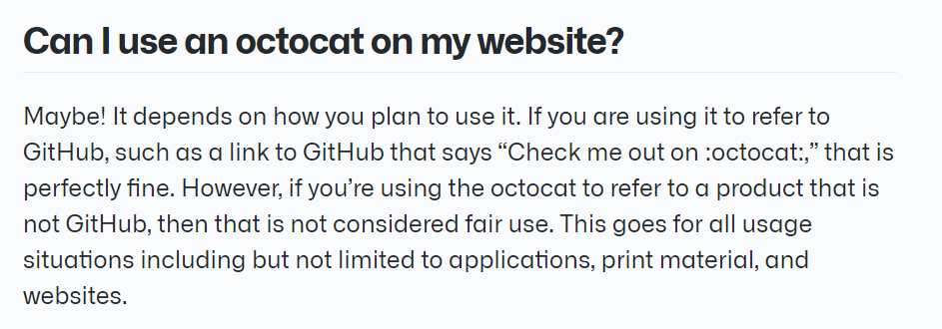

octodex.github
Notes:
_____________ Icons Attribution and link _________________
Octocat github original by Simon: https://octodex.github.com/original/
_____________ Slides notes _________________
Here it is possible to see that GitHub has a strict police that resembles a CC-BY-ND license. It can be used to refer to github, but not to try to link a person or company inadvertently to GitHub. But no adaptations are allowed. In the FAQ session of their page (https://octodex.github.com/faq/) you can also read in another session that other octocats that were not created by people within the company are not accepted.

Slide 29
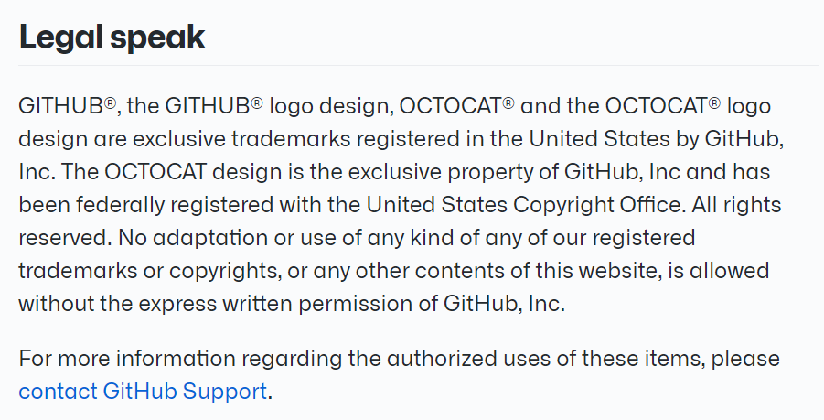
octodex.github
Notes:
_____________ Icons Attribution and link _________________
Octocat github original by Simon: https://octodex.github.com/original/
_____________ Slides notes _________________
Here it is possible to see that GitHub has a strict police that resembles a CC-BY-ND license. It can be used to refer to github, but not to try to link a person or company inadvertently to GitHub. But no adaptations are allowed. In the FAQ session of their page (https://octodex.github.com/faq/) you can also read in another session that other octocats that were not created by people within the company are not accepted.

Slide 30
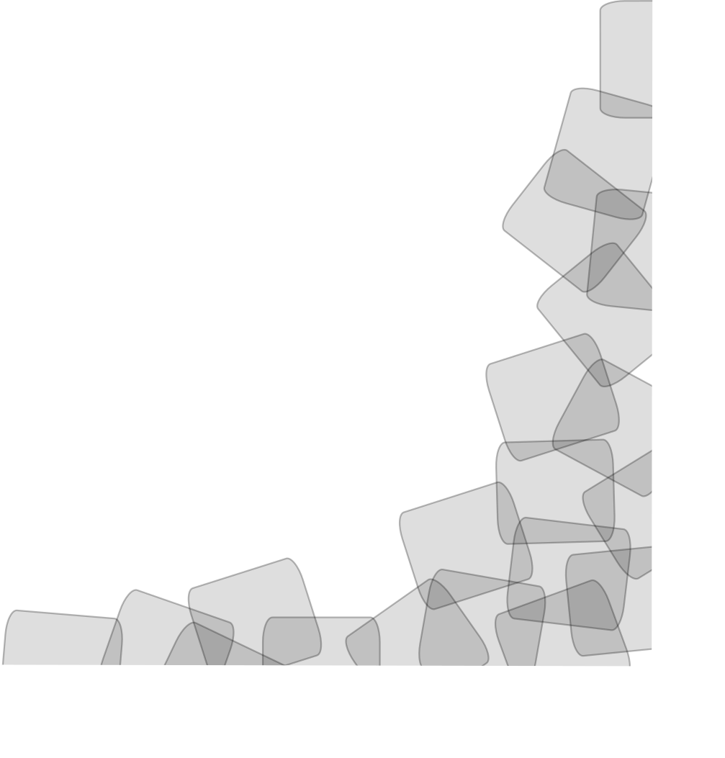
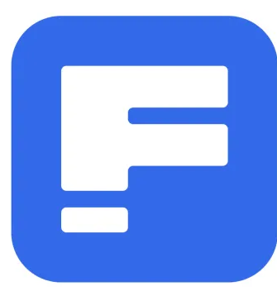



Illustrations challenge
Awknoldgement and how to do it activity: choose illustrations for your presentation in MD
How to embed images in MD
Maybe give the option of searching on it and/or creating with AI as long as following the rules.
Choosing online
Look for:
License
Terms & conditions
Policies
Look at:
..
…
…
Others …..
Notes:
_____________ Icons Attribution and link _________________
Computer by @Vectorsclub on freepick: https://www.freepik.com/icon/graphic-design_15269549#fromView=search&page=1&position=20&uuid=71385200-e380-449d-b51a-f6f271193b9c
Squares superposition corner created by author of this course and under a CC0 4.0 license https://creativecommons.org/public-domain/cc0/
Paint and brush by @AbtoCreative on freepick: https://www.freepik.com/icon/painting_4302155#fromView=search&page=3&position=2&uuid=5ec71ba2-e646-48b0-9dae-9ffd04b3800c
_____________ Slides notes _________________
If you want to use an image you find online, make sure to check the license and the police, it could be that this image has a restrictive license or even close access or is linked to payment. If you cannot find, the advisable measure is not to use it. The easiest way to circuvein this challenge is to look into image/icon/illustrations in dedicated websites that will make easy to know the license/policy and the author/owner.
I have personally been using a lot FreePik, one of the examples listed this slide. There, as much as in Unsplash and Pexels to cite some, you can filter by free licenses and premium ones. They will make it easy for you to know who you should attribute, and even what you can do. Mostly they have premium options that will include more images and also allow to avoid attributions, even though I would advise to whenever possible, even if you a Public domain or CC0 include attribution or at least the link for the original source, this way is easier for other to (re)use it later.
There are more beyond the ones I’ve exemplified here, so take the chance to look for more of those websites when you are in creative mode.

Slide 31



Illustrations challenge
Create your own
Use an illustrator
Formats
SVG - Scalable Vector Graphics
Easily adaptable
Resolution persistence
Easily converted in other formats
PNGs, JPEG
Resolution bound
Not easily Adaptable
Define your license
Adobe Illustrator
Notes:
_____________ Icons Attribution and link _________________
Compass set by @Vectorsclub on freepick: https://www.freepik.com/icon/compass_15268335#fromView=search&page=1&position=9&uuid=7855d1b6-a92f-47c7-b889-549e9eab771b
Squares superposition corner created by author of this course and under a CC0 4.0 license https://creativecommons.org/public-domain/cc0/
Paint and brush by @AbtoCreative on freepick: https://www.freepik.com/icon/painting_4302155#fromView=search&page=3&position=2&uuid=5ec71ba2-e646-48b0-9dae-9ffd04b3800c
_____________ Slides notes _________________
Another option, that you also had the chance to see in this lesson, is to make your own illustrations, the you can freely use and you will choose your own licenses. Inkscape is a free to use illustrator program, while Adobe is maybe more famous but not free. In both you have the same possibilities, choose your favorite and have some fun.
In this course we will not show you how to use them since there is a learning curve and it would require at least half a day to get you started.
This option probably requires, also, more time investment that not always we have if the list of tasks in our hands. But keep this option in mind.
When going for this consider the SVG, this is the FAIRst of the images formats because it will allow to easily adapt, remix, build upon then a PNG or a JPEG. Usually you open it in your illustrator and you can anything you want. The resolution is maintained since it is a vector what also allows to easily adapt sizes to any needed dimension. From SVG you can easily convert into other formats.
While PNG and JPEG are the most commonly found formats, they are not so easily modified and they resolution fix to their original “build”.

Slide 32
Illustrations challenge
Create your own
Use an illustrator
Formats
SVG - Scalable Vector Graphics
Easily adaptable
Resolution persistence
Easily converted in other formats
PNGs, JPEG
Resolution bound
Not easily Adaptable
Define your license
Learning curve
Time investment
Notes:
_____________ Icons Attribution and link _________________
Compass set by @Vectorsclub on freepick: https://www.freepik.com/icon/compass_15268335#fromView=search&page=1&position=9&uuid=7855d1b6-a92f-47c7-b889-549e9eab771b
Squares superposition corner created by author of this course and under a CC0 4.0 license https://creativecommons.org/public-domain/cc0/
Paint and brush by @AbtoCreative on freepick: https://www.freepik.com/icon/painting_4302155#fromView=search&page=3&position=2&uuid=5ec71ba2-e646-48b0-9dae-9ffd04b3800c
_____________ Slides notes _________________
Just a reminder that there is a learning curve and more time investment then looking up in the internet. Tho finding licensed images on the internet will also take more time then taking random images you find in a fast browser search!
But it is important!
Let’s include this is our planning.

Slide 33
the wonders of
Generative AI illustration
Notes:
_____________ Icons Attribution and link _________________
Ai assistant by @Freepik: https://www.freepik.com/icon/ai-assistant_14247371#fromView=search&page=1&position=4&uuid=72609963-4de7-4115-ba4c-7127049de747
_____________ Slides notes _________________

Slide 34
?
?
HAVE YOU USED FOR
YOUR COURSES
Notes:
_____________ Icons Attribution and link _________________
Ai assistant by @Freepik: https://www.freepik.com/icon/ai-assistant_14247371#fromView=search&page=1&position=4&uuid=72609963-4de7-4115-ba4c-7127049de747
_____________ Slides notes _________________
Ask if they’ve used and for what

Slide 35
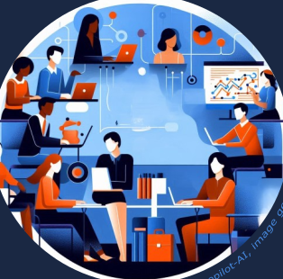
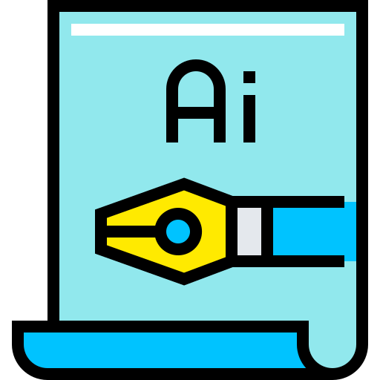
Illustrations challenge
Generative AI (genAI)
?
?
You open the browser
You prompt an image
The image is generated
WHO OWNS THE ILLUSTRATION ?
june 2024)
(microsoft
by copilot-AI
Generated
Notes:
_____________ Icons Attribution and link _________________
AI drawing: https://www.freepik.com/icon/ai-file_1791897#fromView=search&page=1&position=24&uuid=d859101d-8ece-4f9f-9bcc-d30022f38bf9
Paint and brush by @AbtoCreative on freepick: https://www.freepik.com/icon/painting_4302155#fromView=search&page=3&position=2&uuid=5ec71ba2-e646-48b0-9dae-9ffd04b3800c
_____________ Slides notes _________________
Describe the process shortly and reflect with them who they think owns the image generated by AI

Slide 36
Illustrations challenge
Generative AI (genAI)
?
?
You open the browser
You prompt an image
The image is generated
WHO OWNS THE ILLUSTRATION ?
The owners of the model
The person prompting
If there are obvious reference of an object with copyrights …
This person could reinforce the terms of their policies ?
june 2024)
(microsoft
by copilot-AI
Generated
Notes:
_____________ Icons Attribution and link _________________
AI drawing: https://www.freepik.com/icon/ai-file_1791897#fromView=search&page=1&position=24&uuid=d859101d-8ece-4f9f-9bcc-d30022f38bf9
Paint and brush by @AbtoCreative on freepick: https://www.freepik.com/icon/painting_4302155#fromView=search&page=3&position=2&uuid=5ec71ba2-e646-48b0-9dae-9ffd04b3800c
_____________ Slides notes _________________
There is some ongoing discussion and reflections that the owners of the models could have some right over it since it was created with their model, others defend that if you’ve prompted it, since you are the thinking mind behind describing what is expected then the person behind the computer is the one to owns it. On that matter the updated policies make sure to give up any rights that there could be.
That leaves to the prompter some more responsibility, because since mostly we don’t have information about the data used to train the models we cannot be sure if they’ve kept out images that are copyrighted. So you/us need to be careful that copyrighted images might not be incorporated in the genAI images that we are using.
In the upcoming slides I’ll try to summarize some things you can try to minimize the risk of bumping into this issue.

Slide 37
Sufficiently different from existing work
Prompting is key
Be mindful when prompting
Referencing other works
AI biases awareness
Avoid very generalized suggestions
Use for ideas and inspirations
Combine human work
What to do if you use it:
AI images copyrights by Anas Hassan, feb 2023
Notes:
_____________ Icons Attribution and link _________________
Ai assistant by @Freepik: https://www.freepik.com/icon/ai-assistant_14247371#fromView=search&page=1&position=4&uuid=72609963-4de7-4115-ba4c-7127049de747
_____________ Slides notes _________________
The 1st thing is to try to create sufficiently different images from what is out there. Being very general might bring up things that are similar to pre-existante, but citing references can also bring very similar results.
We must remember these are statical based models, so ther more something is referenced in the internet usually more representative in the models, more likely it will be similar.
I’ll give you two examples

Slide 38
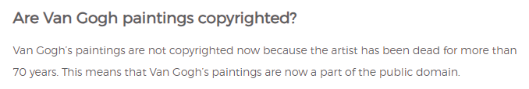
Sufficiently different from existing work
Prompting is key
Be mindful when prompting
Referencing other works
AI biases awareness
Avoid very generalized suggestions
Use for ideas and inspirations
Combine human work
What to do if you use it:
AI images copyrights by Anas Hassan, feb 2023
Notes:
_____________ Icons Attribution and link _________________
Ai assistant by @Freepik: https://www.freepik.com/icon/ai-assistant_14247371#fromView=search&page=1&position=4&uuid=72609963-4de7-4115-ba4c-7127049de747
_____________ Slides notes _________________
Asking to have Van Gogh as a reference will bring a lot of similar drawing in his paint style but also beyond his style it might be almost direct to an attempt of replicate. In this case it should be ok since his work is under public domain (we’ve have already discussed licenses)

Slide 39

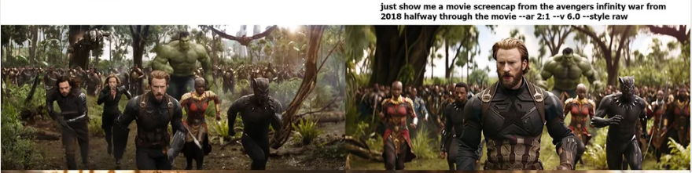
Sufficiently different from existing work
Prompting is key
Be mindful when prompting
Referencing other works
AI biases awareness
Avoid very generalized suggestions
Use for ideas and inspirations
Combine human work
What to do if you use it:
AI images copyrights by Anas Hassan, feb 2023
: Very strict copyrights!
Original
genAI
By Gary Marcus Reid Southen JAN 2024 - https://spectrum.ieee.org/midjourney-copyright
Notes:
_____________ Icons Attribution and link _________________
Ai assistant by @Freepik: https://www.freepik.com/icon/ai-assistant_14247371#fromView=search&page=1&position=4&uuid=72609963-4de7-4115-ba4c-7127049de747
_____________ Slides notes _________________
In other hands any mentions to the Disney world might get you in trouble since they have very strict copyrights rules. The biggest challenge is that in some models even a non-direct mention can bring this references and in sometimes is close to identical to the original as you can see in the example from Gary Marcus (see more about his tests https://spectrum.ieee.org/midjourney-copyright).
In this cases they can claim copyrights and in the current stat of art disputes might be evaluated case-by-case

Slide 40
Sufficiently different from existing work
Prompting is key
Use for ideas and inspirations
Combine human work
What to do if you use it:
AI images copyrights by Anas Hassan, feb 2023
Notes:
_____________ Icons Attribution and link _________________
Ai assistant by @Freepik: https://www.freepik.com/icon/ai-assistant_14247371#fromView=search&page=1&position=4&uuid=72609963-4de7-4115-ba4c-7127049de747
_____________ Slides notes _________________
That is why it is advised to use it more for inspiration before and human interference should be combined. Prompt ideas, get them into the illustrator and adjust them.

Slide 41
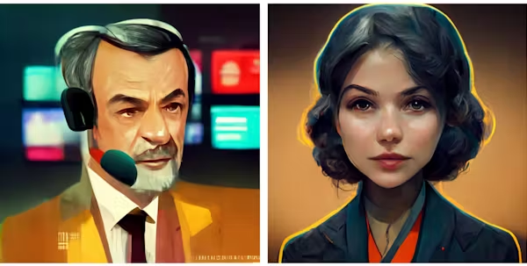
Sufficiently different from existing work
Prompting is key
Use for ideas and inspirations
Combine human work
Be mindful when prompting
Referencing other works
Avoid very generalized suggestions
AI biases awareness
What to do if you use it:
AI images copyrights by Anas Hassan, feb 2023
By T.J. Thomson and Ryan J. Thomas
https://theconversation.com/ageism-sexism-classism-and-more-7-examples-of-bias-in-ai-generated-images-208748
Notes:
_____________ Icons Attribution and link _________________
Ai assistant by @Freepik: https://www.freepik.com/icon/ai-assistant_14247371#fromView=search&page=1&position=4&uuid=72609963-4de7-4115-ba4c-7127049de747
_____________ Slides notes _________________
Again, is good to remember as an statical model trained with a lot of the content in the internet, so it might reflect societal challenges such as ageism, sexism, classism, racism. So it is important to actively act into writing prompts to avoid or minimize it, you might need some reiterations .
In the one of the example images extracted from the journal article written by TJ thomson and RJ Thoma you can when asked to draw a representations of a journalist one man and one women, man are older and have therefore some wrinkles . While women are wonger and don’t have wrinkles. In both we see some more light skin tons features and conservative looks.
So be mindful when referring to others works, avoiding generalizations and acting against this biases.

Slide 42
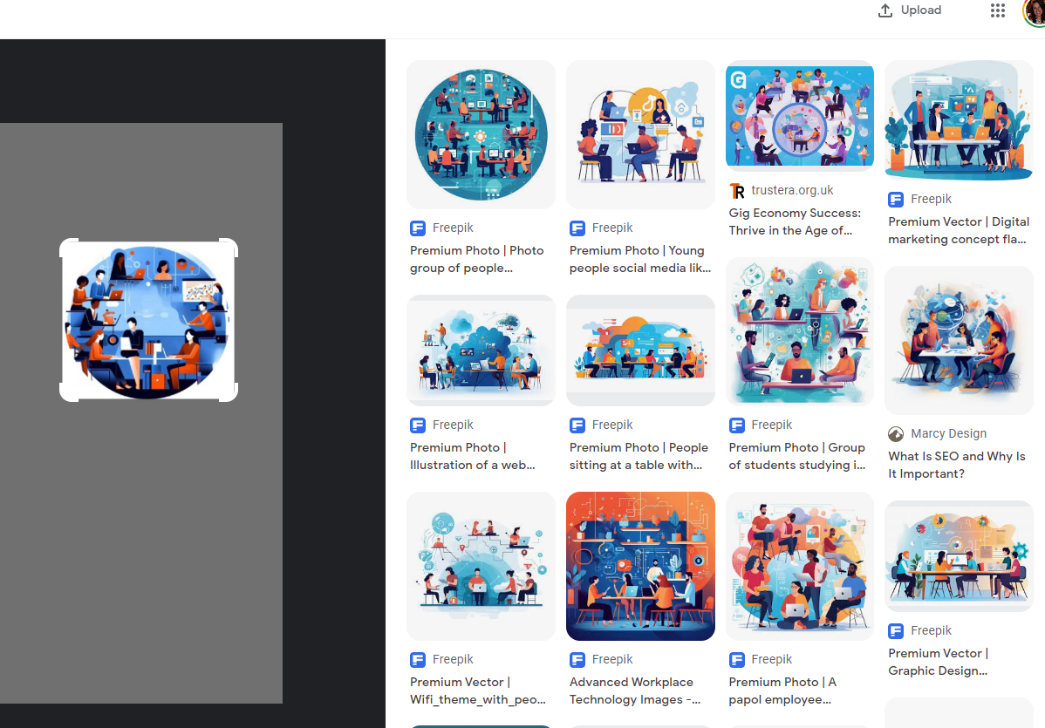
Use reverse image search
Check for existent work
Inform the use of AI
Model and version (when possible)
Check AI policies
Commercial use
Save the prompt as part of image data
What to do if you use it:
AI images copyrights by Anas Hassan, feb 2023
Notes:
_____________ Icons Attribution and link _________________
Ai assistant by @Freepik: https://www.freepik.com/icon/ai-assistant_14247371#fromView=search&page=1&position=4&uuid=72609963-4de7-4115-ba4c-7127049de747
_____________ Slides notes _________________
A helpful step, specially to try to track for copyrighted references is to do reverse image search. You have an example here that shows a lot of alike images, in this case they are all generated by AI and don’t seem to have copyrighted elements. Nonetheless you can observe that there is a tendency where images look very similar. Probably these images are used back to keep training the models.

Slide 43
Use reverse image search
Check for existent work
Inform the use of AI
Model and version (when possible)
Check AI policies
Commercial use
Save the prompt as part of image data
What to do if you use it:
AI images copyrights by Anas Hassan, feb 2023
june 2024)
(microsoft
by copilot-AI
Generated
Notes:
_____________ Icons Attribution and link _________________
Ai assistant by @Freepik: https://www.freepik.com/icon/ai-assistant_14247371#fromView=search&page=1&position=4&uuid=72609963-4de7-4115-ba4c-7127049de747
_____________ Slides notes _________________
Whenever you do, you have checked all the before is good to make clear that AI was used and which tool and model version was used

Slide 44
Use reverse image search
Check for existent work
Inform the use of AI
Model and version (when possible)
Check AI policies
Information is used for re-training models
Save the prompt
Save the prompt as part of image data
What to do if you use it:
AI images copyrights by Anas Hassan, feb 2023
Notes:
_____________ Icons Attribution and link _________________
Ai assistant by @Freepik: https://www.freepik.com/icon/ai-assistant_14247371#fromView=search&page=1&position=4&uuid=72609963-4de7-4115-ba4c-7127049de747
_____________ Slides notes _________________
And when possible save the prompt as image data and always check the policies since they are being constantly updated. I’ll give two examples in the upcoming slides

Slide 45



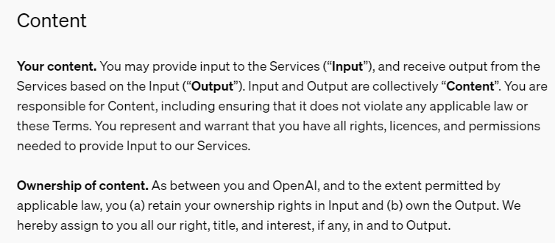
https://openai.com/policies/terms-of-use/
Notes:
_____________ Icons Attribution and link _________________
Ai assistant by @Freepik: https://www.freepik.com/icon/ai-assistant_14247371#fromView=search&page=1&position=4&uuid=72609963-4de7-4115-ba4c-7127049de747
_____________ Slides notes _________________

Slide 46
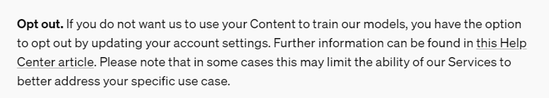
https://openai.com/policies/terms-of-use/
Notes:
_____________ Icons Attribution and link _________________
Ai assistant by @Freepik: https://www.freepik.com/icon/ai-assistant_14247371#fromView=search&page=1&position=4&uuid=72609963-4de7-4115-ba4c-7127049de747
_____________ Slides notes _________________

Slide 47
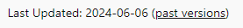
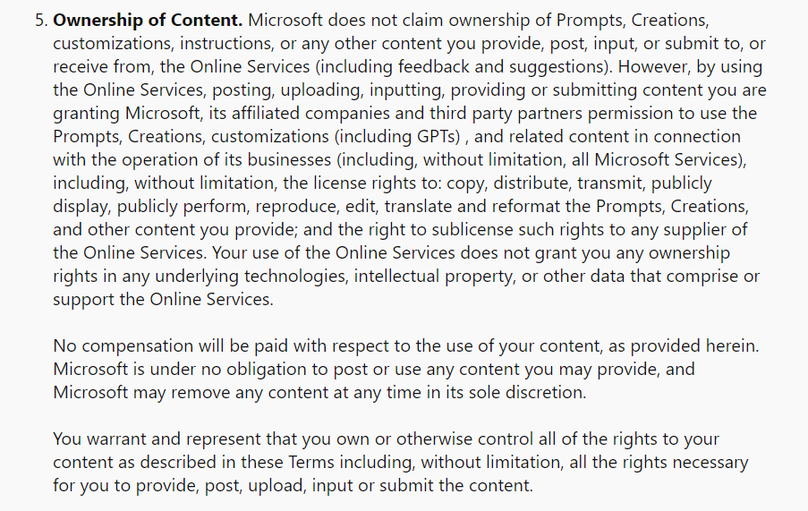
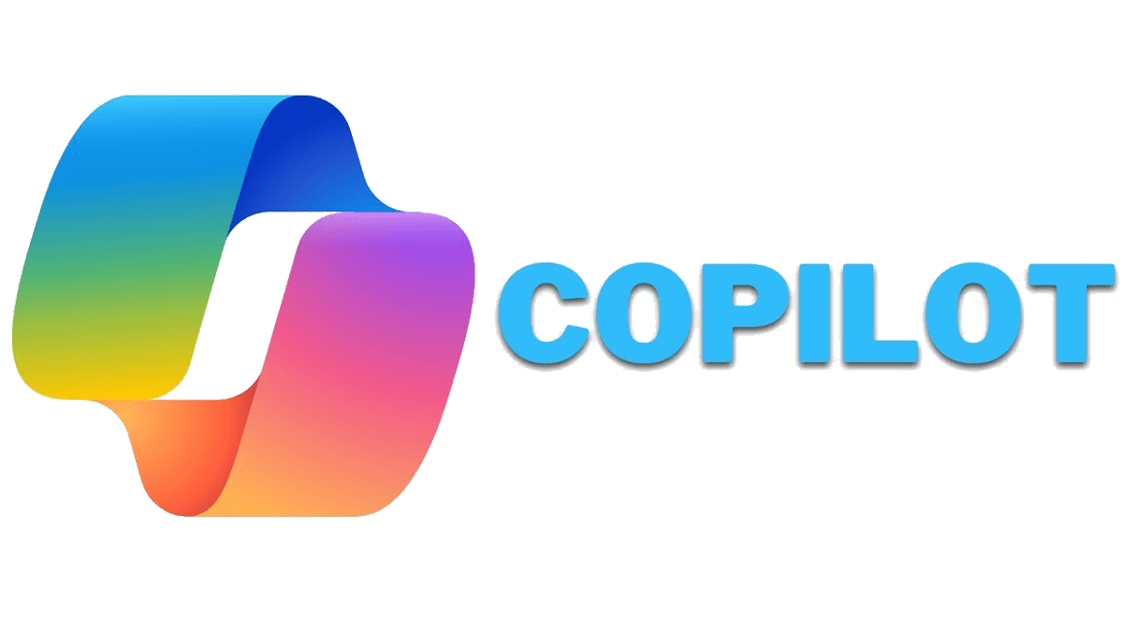
https://www.bing.com/new/termsofuse
Notes:
_____________ Icons Attribution and link _________________
Ai assistant by @Freepik: https://www.freepik.com/icon/ai-assistant_14247371#fromView=search&page=1&position=4&uuid=72609963-4de7-4115-ba4c-7127049de747
_____________ Slides notes _________________

Slide 48
Use reverse image search
Check for existent work
Inform the use of AI
Model and version (when possible)
Check AI policies
Commercial use
Save the prompt as part of image data
What to do if you use it:
AI images copyrights by Anas Hassan, feb 2023
Notes:
_____________ Icons Attribution and link _________________
Ai assistant by @Freepik: https://www.freepik.com/icon/ai-assistant_14247371#fromView=search&page=1&position=4&uuid=72609963-4de7-4115-ba4c-7127049de747
_____________ Slides notes _________________

Slide 49
question
?
?

